Slide 1
Multitouch Paper Recognising Gestures
(with vvvv)
by hannah and joreg

Slide 2
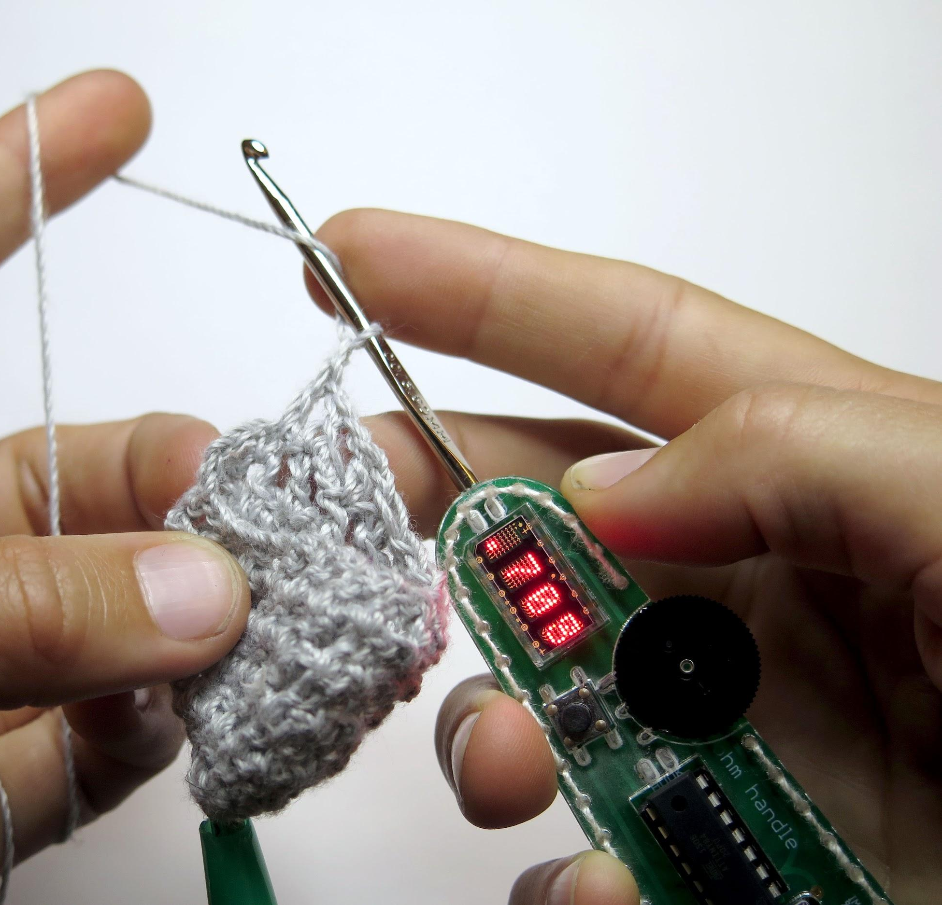
hannah perner-wilson
www.plusea.at
www.kobakant.at
www.howtogetwhatyouwant.at
joreg
vvvv.org
checksum5.com
joreg.ath.cx
Mastodon: @joreg@vis.social

Slide 3
PART 1 (12-14:30)
Multitouch
Paper
or:
how to translate
world to computer
PART 2 (15-17:30)
Recognising Gestures
or:
getting a taste for visual programming
with vvvv

Slide 4
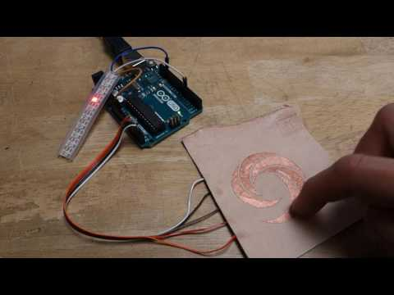
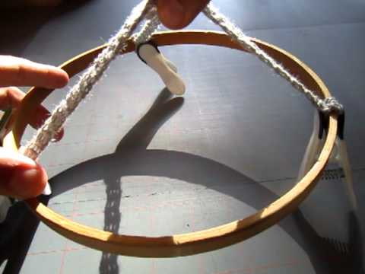
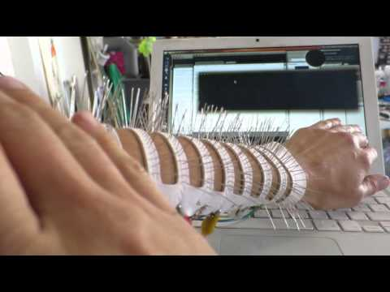
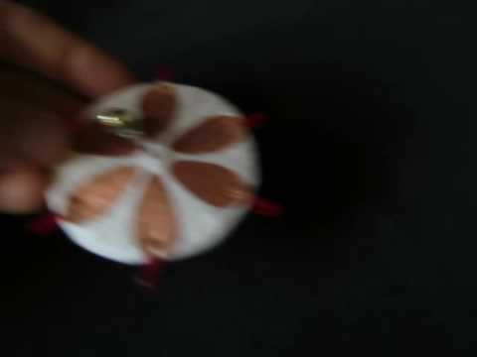
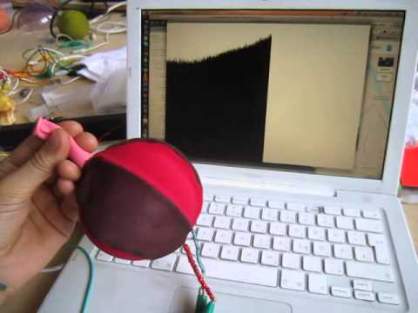
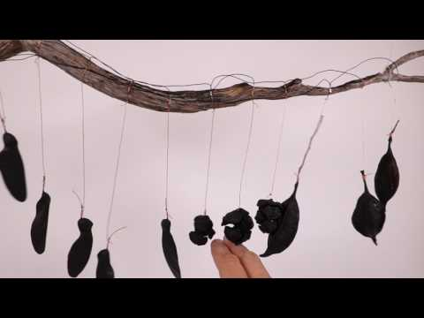
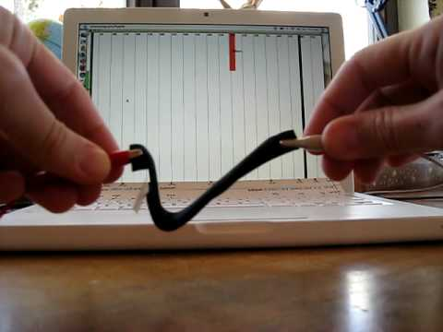
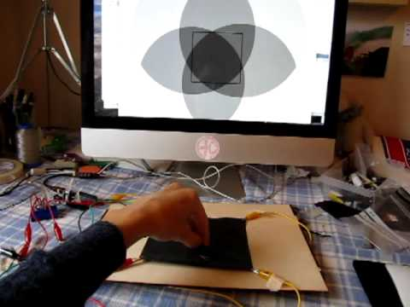
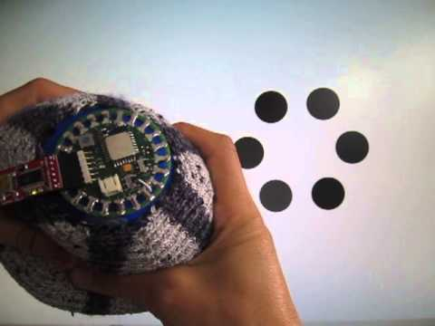

Slide 5
PART 1 (12-14:30)
Multitouch
Paper
or:
how to translate
world to computer
PART 2 (15-17:30)
Recognising Gestures
or:
getting a taste for visual programming
with vvvv

Slide 6
vvvv examples

Slide 7
MATRIX
DEMOS

Slide 8
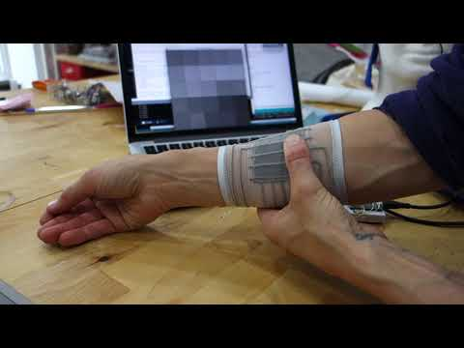

Slide 9
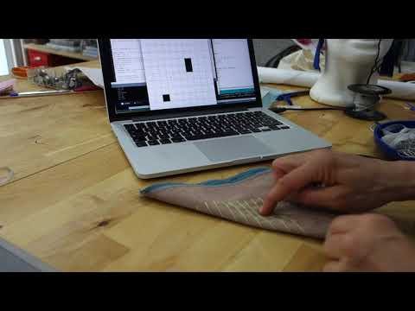

Slide 10
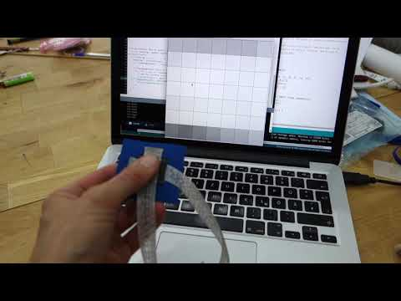

Slide 11
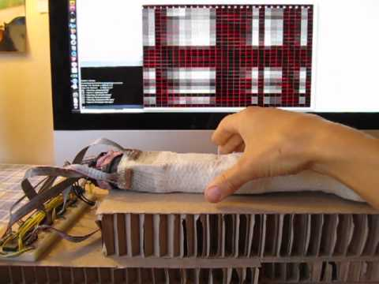

Slide 12
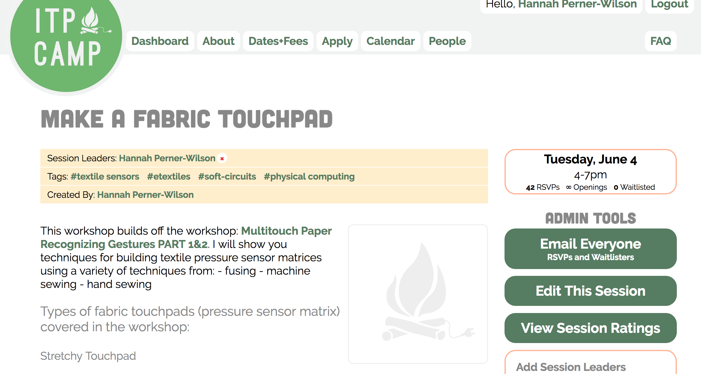
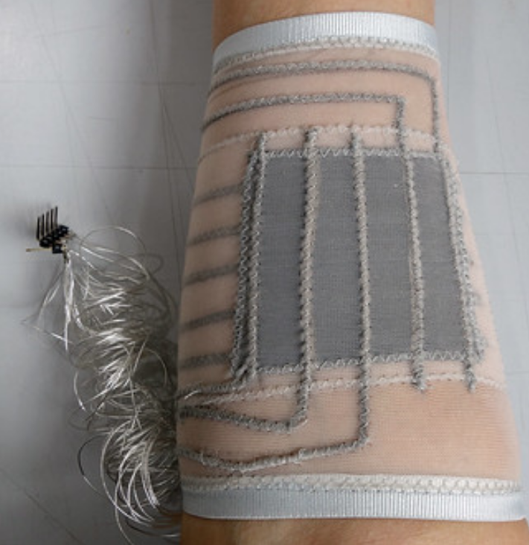

Slide 13
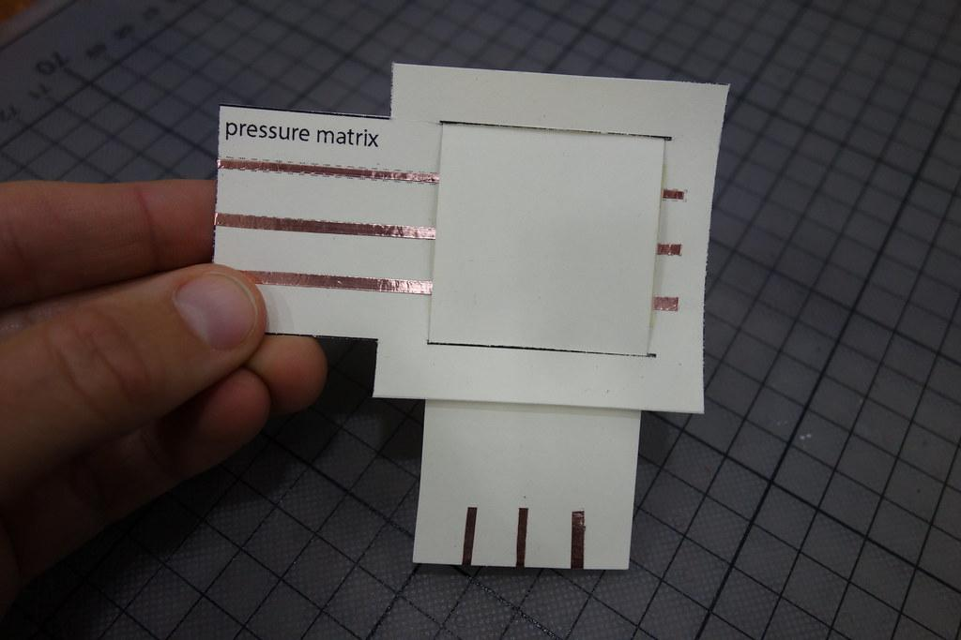

Slide 14
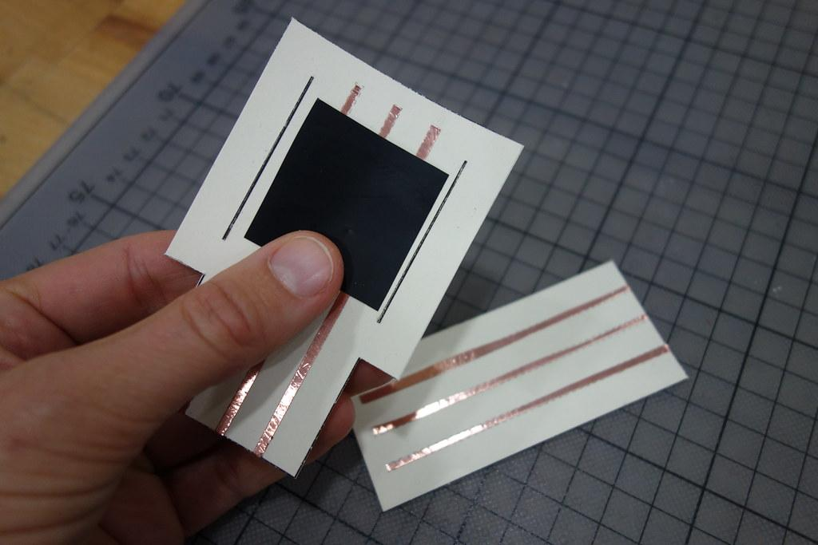
lets go!

Slide 15
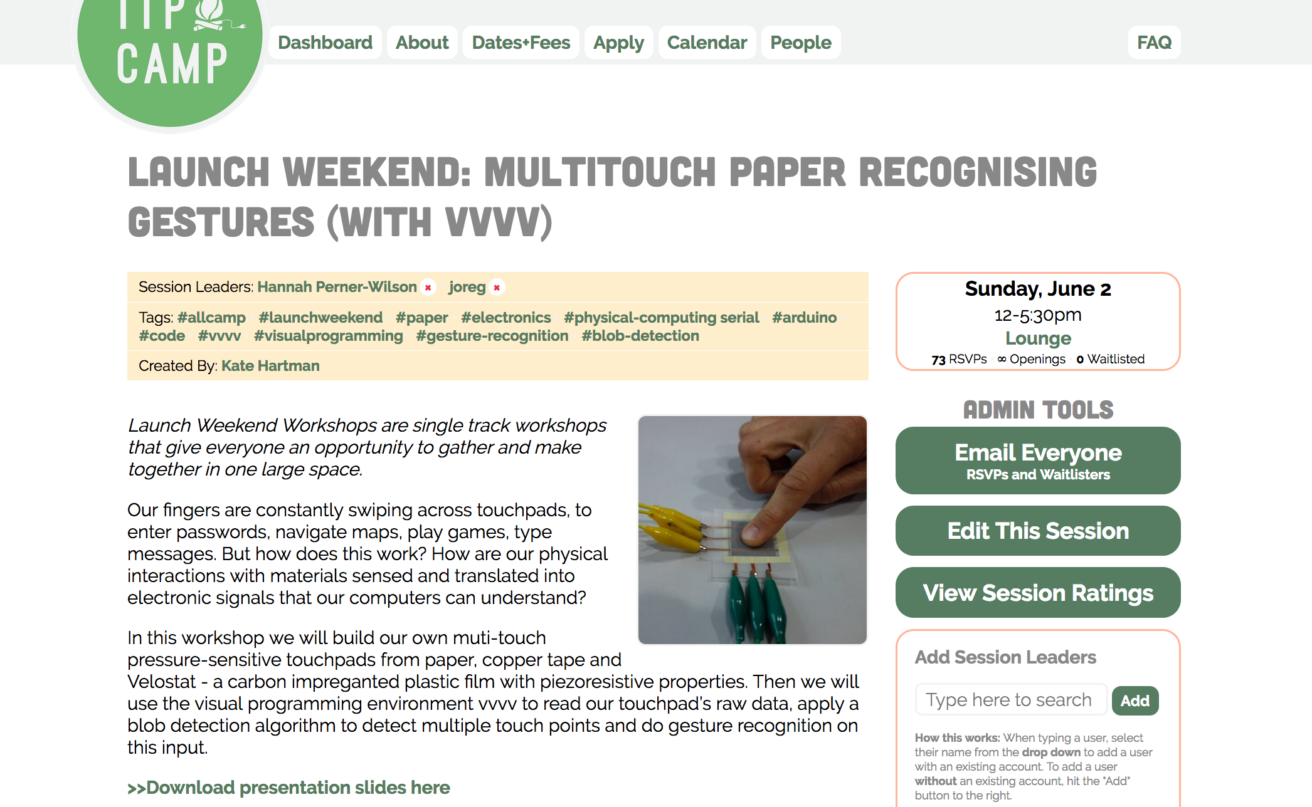
links to….
Slides
Code examples

Slide 16
PART 1 (12-14:30)
Multitouch
Paper
or:
how to translate
world to computer

Slide 17
extra slides

Slide 18
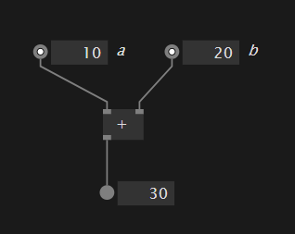
Visual Programming
Listing of visual programming environments:
http://blog.interfacevision.com/design/design-visual-progarmming-languages-snapshots/
eg. Processing eg. vvvv
int a = 10; int b = 20; println(a + b);

Slide 19
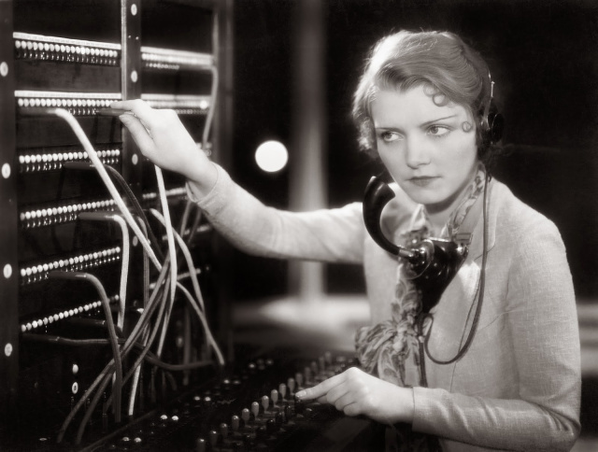
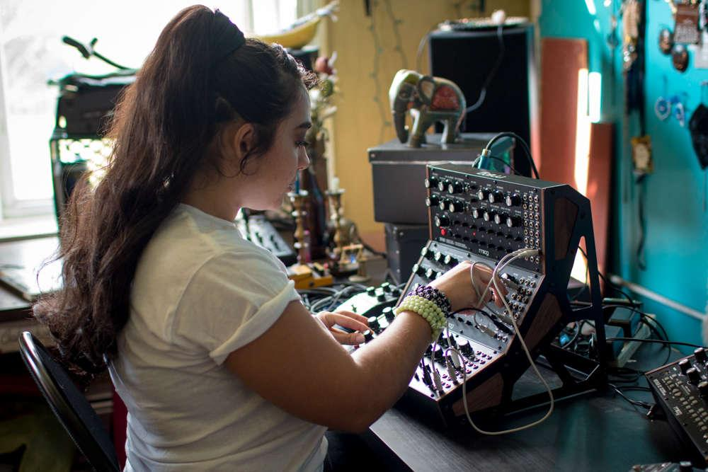
Coding vs. Patching
Patching phone lines
Patching an analog synthesizer

Slide 20
Visual Programming
Why use visual programming?
It is a matter of taste: some simply don’t feel comfortable writing code
It can be faster for certain scenarios
It can help you understand a programs structure better
…
Disadvantages
Harder to share code
Hard to do Version Control
...

Slide 21
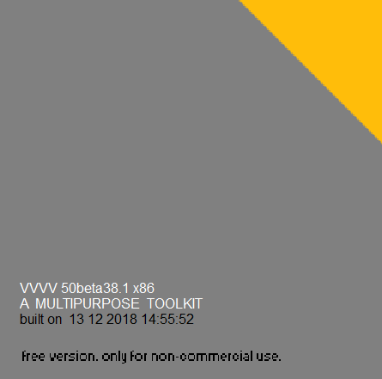
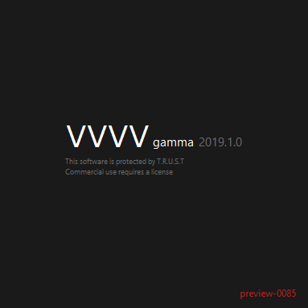
vvvv
vvvv beta
since December 2002
Windows only
Cannot export programs
Dataflow only
vvvv gamma
in preview since April 2019
Will be cross platform
Will export programs
Dataflow and Object Oriented Programming

Slide 22
vvvv gamma Preview
More details about new features:
https://vvvv.org/blog/vvvv-gamma-2019.1-preview
To get your vvvv questions answered:
https://vvvv.org/forums

